Slide 1
Marketing and Retail Analytics Project - Milestone 2

Slide 2
Agenda & Executive Summary of the data
Contents
* Data set and problem statement
* Exploratory Data Analysis and Inferences
* Market Basket Analysis
* Inferences from MBA analysis and Recommendations
Problem statement
The data set provided to you is the data set of a Café Chain for one of its restaurants. Do a thorough analysis of the data and come up with a set of recommendations that can help his Café Chain increase its revenues. The owner is able to provide you with a data set for POS (point of sale data) for one of his chains.

Slide 3
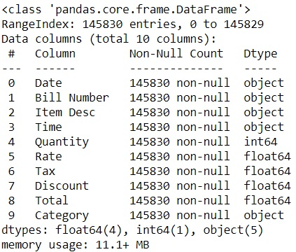
About data set
The given dataset contains 145830 rows and 10 columns of data.
It has four float data type, one integer data type and 5 object data type of columns.
The dataset has both no null values and no duplicate rows of data
There is presence of outliers in variables such as Quantity,Rate,Tax and Total.
Variable ‘Discount’ has highest positive skewness(106.09) and Variable ‘Rate’ has lowest positive skewness(1.566)

Slide 4
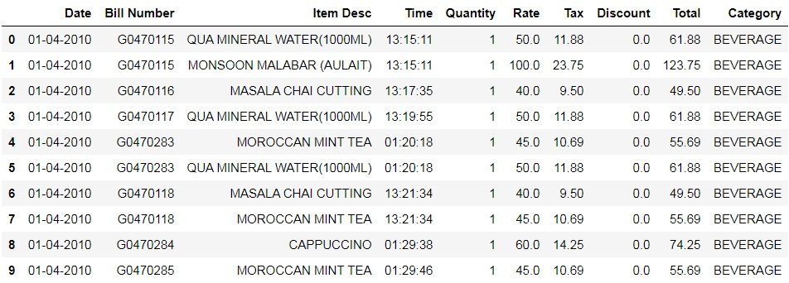
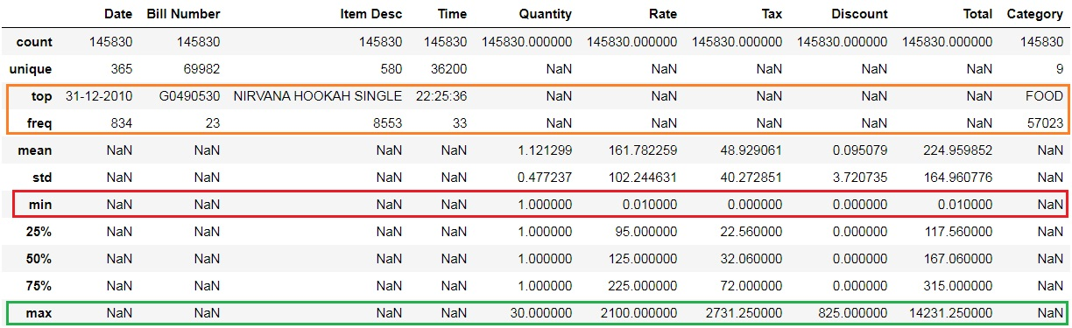
Data Head
Maximum and Minimum values for respective numerical variables are highlighted in Green and Red colors
Top and Freq for respective string variables are highlighted in Orange color

Slide 5
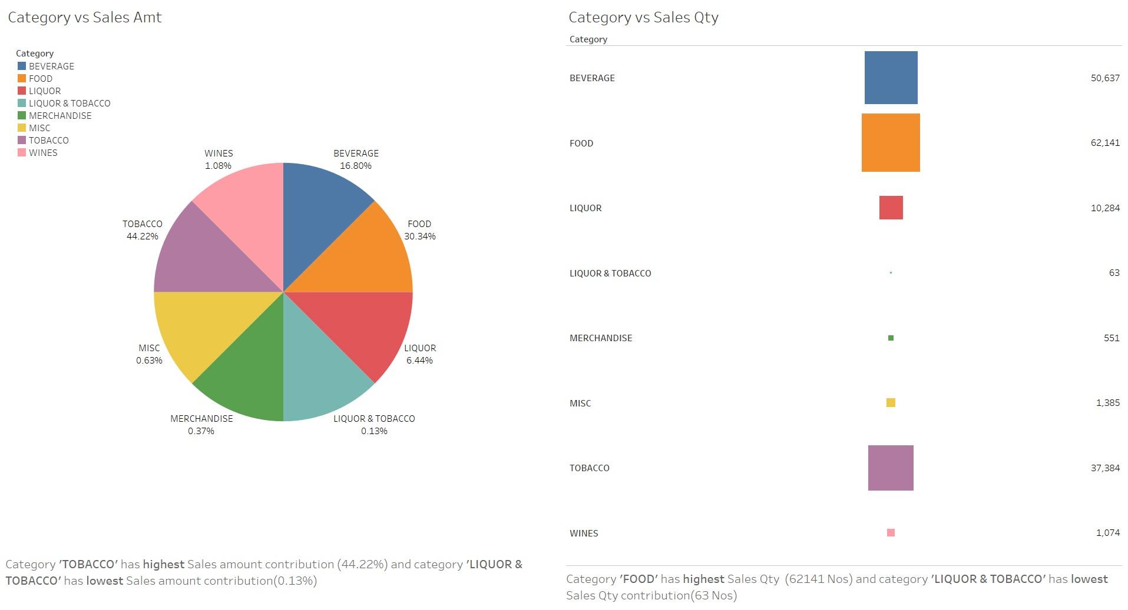
Exploratory Analysis and Inferences

Slide 6
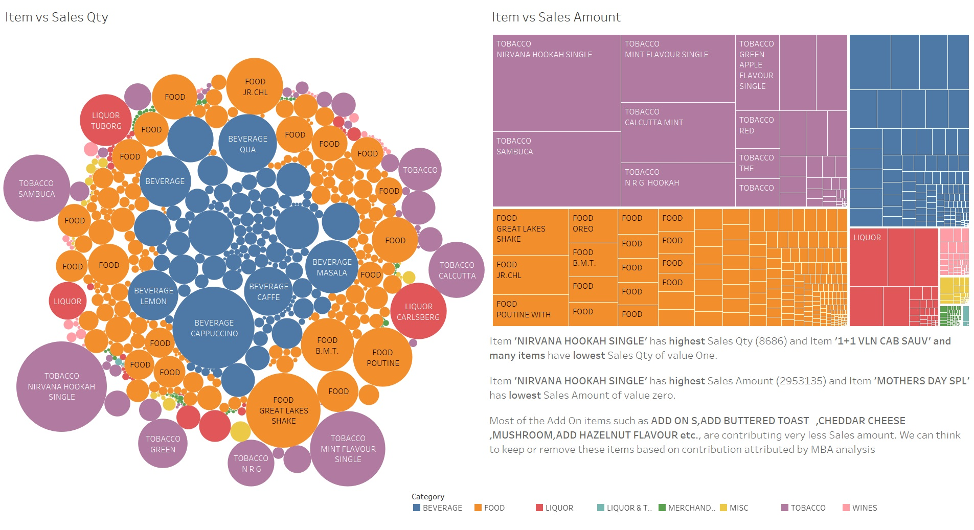

Slide 7
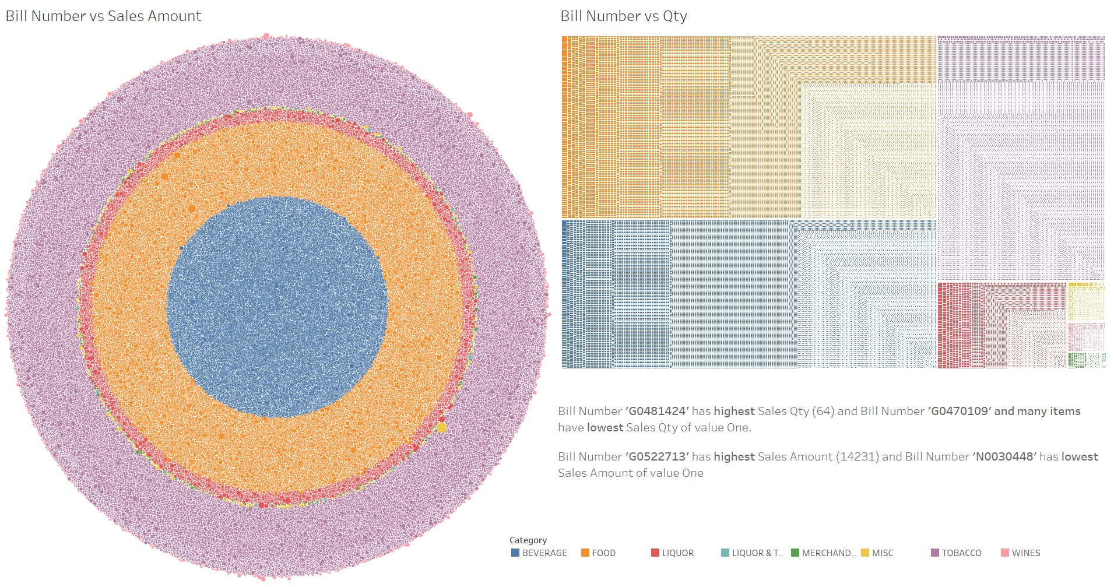

Slide 8
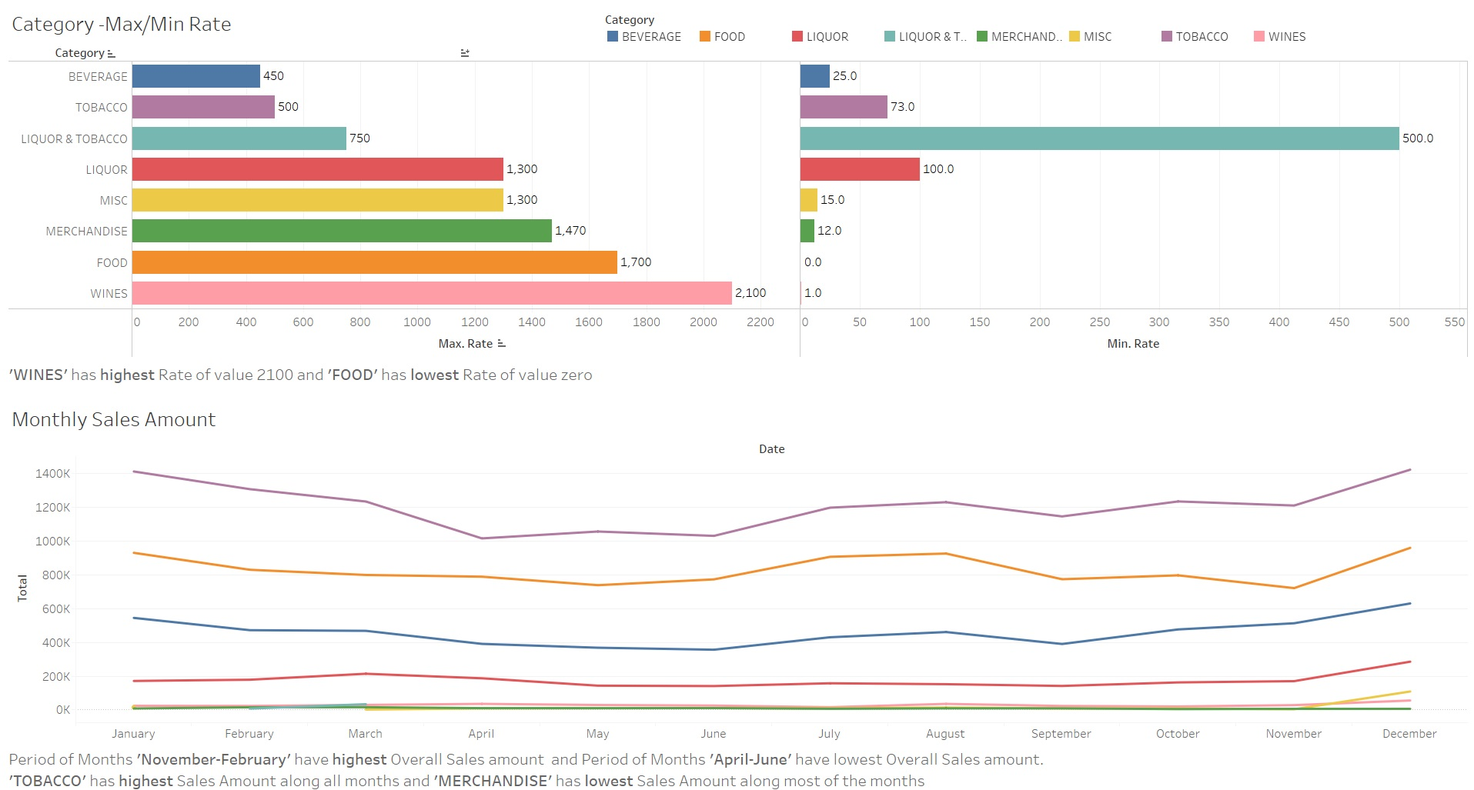

Slide 9
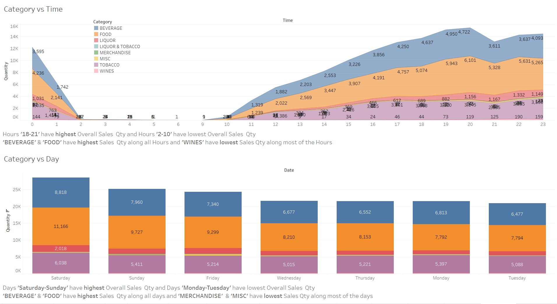

Slide 10
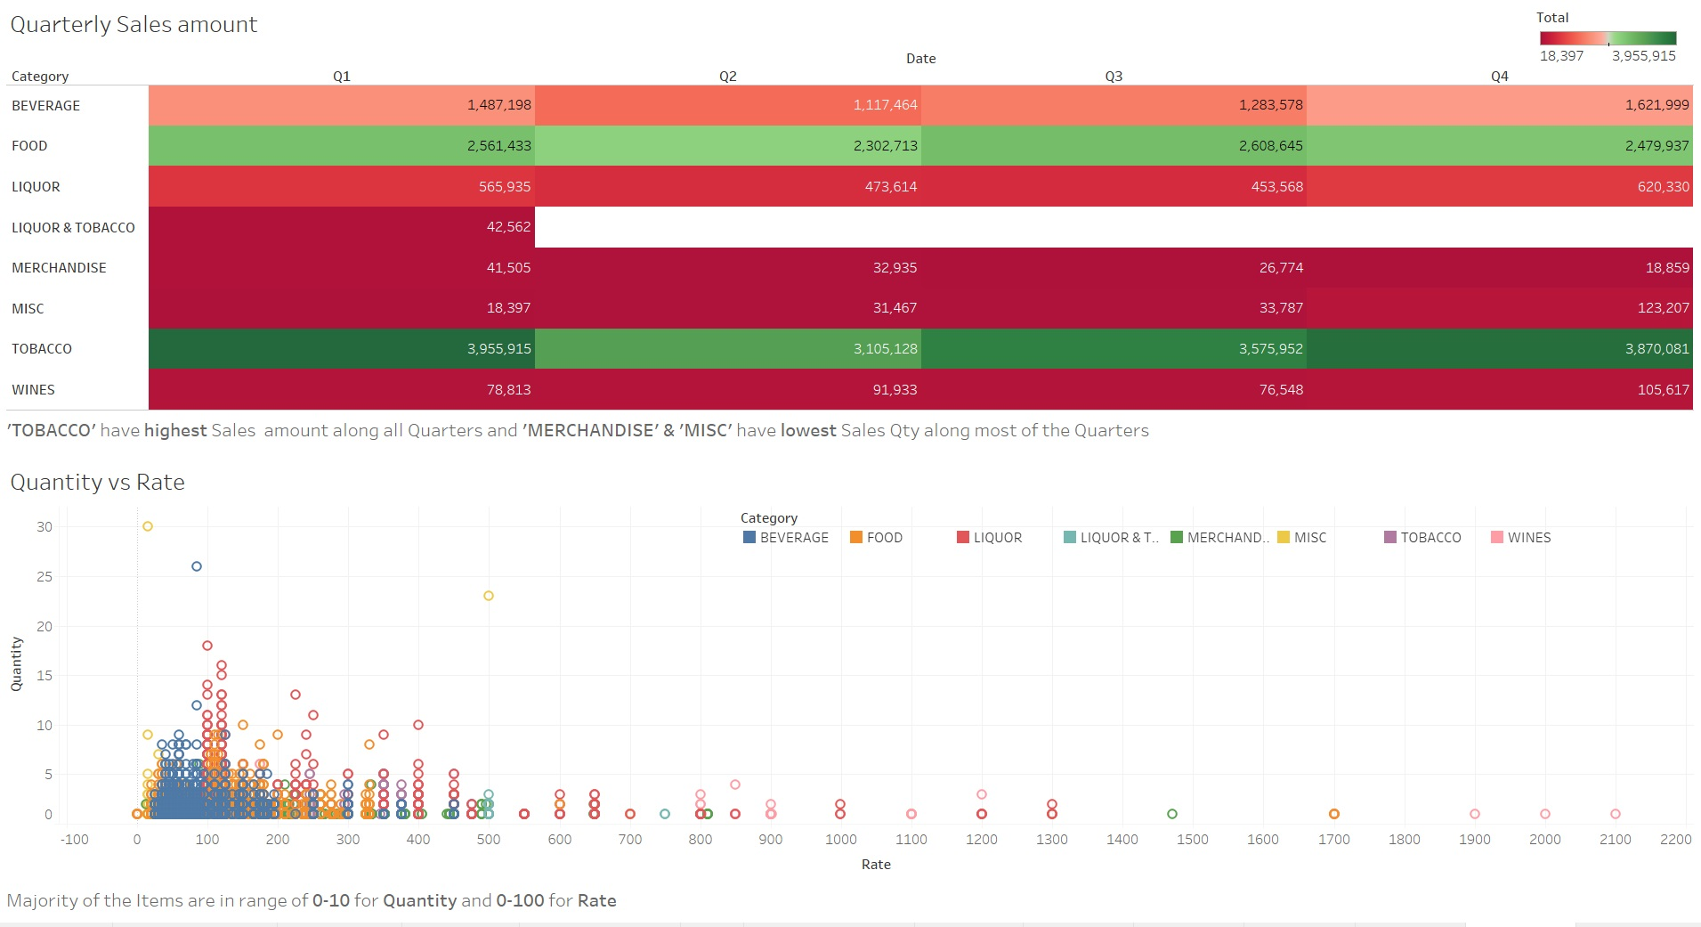

Slide 11
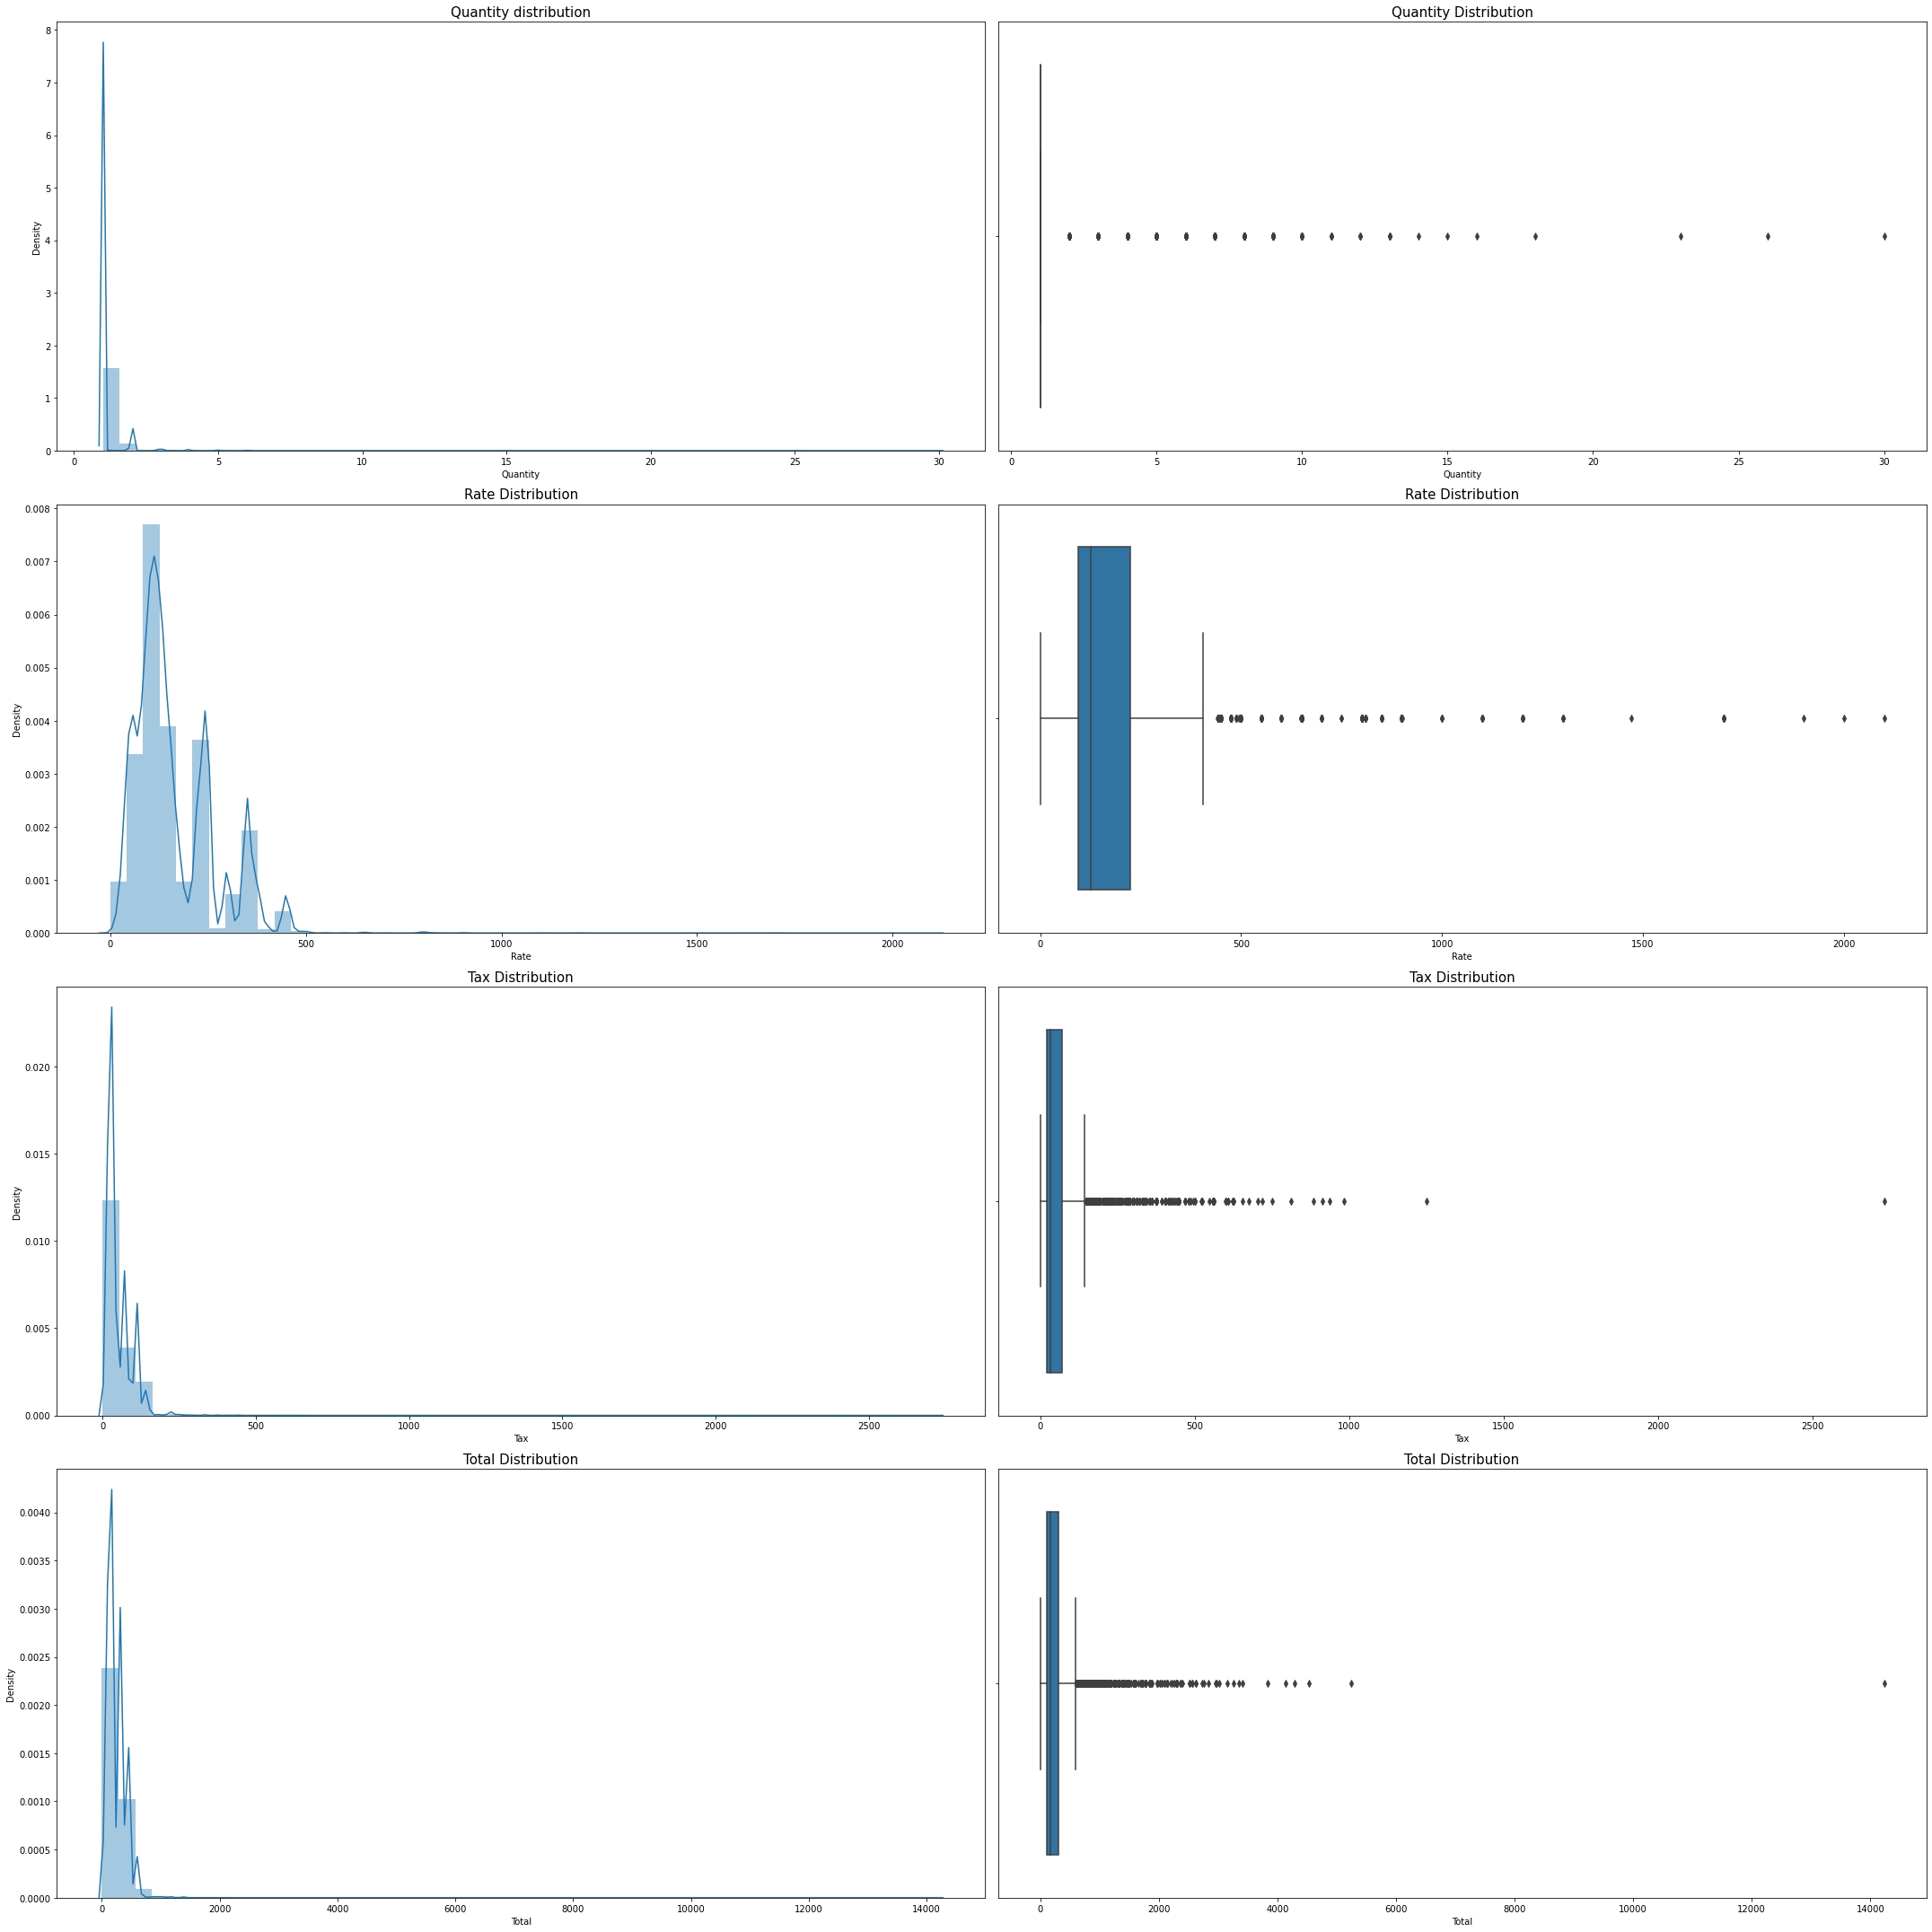
Distplot and Boxplot distribution
There is presence of outliers in variables such as Quantity,Rate and Total.
Variable ‘Discount’ has highest positive skewness(106.09) and Variable ‘Rate’ has lowest positive skewness(1.566)

Slide 12
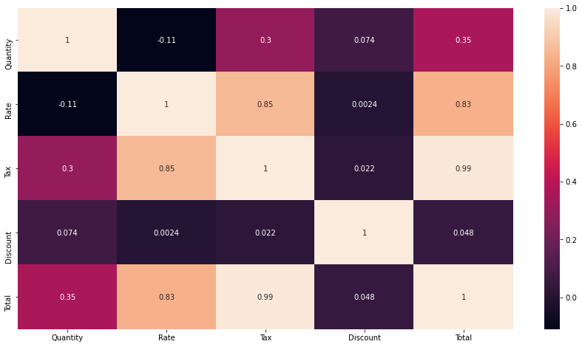
Heat Map
Variables ‘Total’ and ‘Tax’ have highest positive Correlation(0.988) and Variables ‘Quantity’ and ‘Rate’ have highest negative Correlation(-0.11)

Slide 13
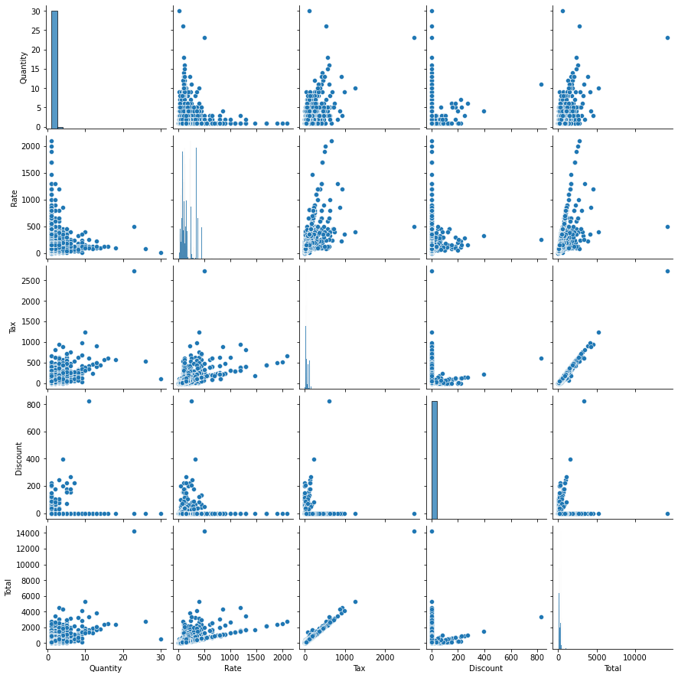
Pair Plot
From the plot , we can see that none of the variables are symmetric
Variables ‘Total’ and ‘Tax’ have almost linear realtionship between them.

Slide 14
Menu analysis
Association rules helps us finding interesting associations and relationships among large sets of data items. This rule shows how frequently a itemset occurs in a transaction.
A typical example is Market Basket Analysis.
Market Basket Analysis is one of the key techniques used by large relations to show associations between items. It allows retailers to identify relationships between the items that people buy together frequently.
Given a set of transactions, we can find rules that will predict the occurrence of an item based on the occurrences of other items in the transaction.
This association rule has 2 parts : an antecedent (if) and a consequent (then). An antecedent is something that’s found in data, and a consequent is an item that is found in combination with the antecedent

Slide 15
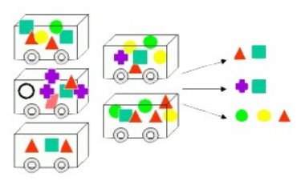
Association rules are created by thoroughly analyzing data and looking for frequent if/then patterns. Then, depending on the following two parameters, the important relationships are observed:
Support: Support indicates how frequently the if/then relationship appears in the database.
Confidence: Confidence tells about the number of times these relationships have been found to be true.
So, in a given transaction with multiple items, Association Rule Mining primarily tries to find the rules that govern how or why such products/items are often bought together.

Slide 16
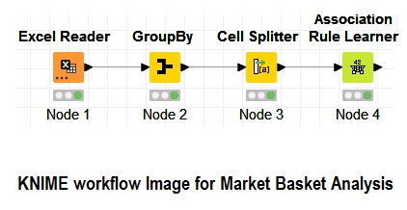
KNIME WorkFlow Image and Threshold
We have taken following threshold values for calculation of frequent itemsets through association rule learner
Minimum Support – 0.0006 (Probability of having particular item out of all items )
Minimum Confidence - 0.1 (Probability of having certain item when there are particular items already in the basket)

Slide 17
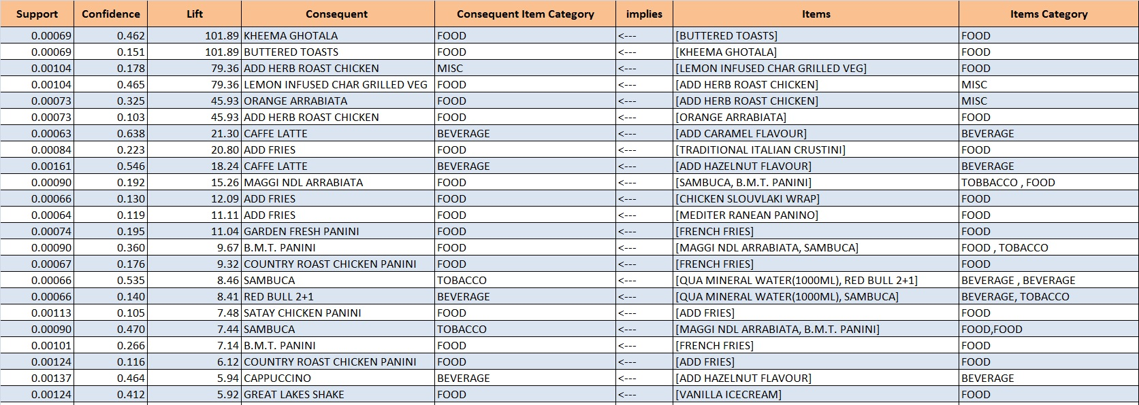
Association Table
From above table, for row 1, Support(0.00069) indicates how frequently the given item appears with respect to all items.
Confidence(0.462) indicates the chance of having the consequent item (KHEEMA GHOTALA) when BUTTERED TOASTS is ordered.
Lift is the ratio of confidence to support

Slide 18
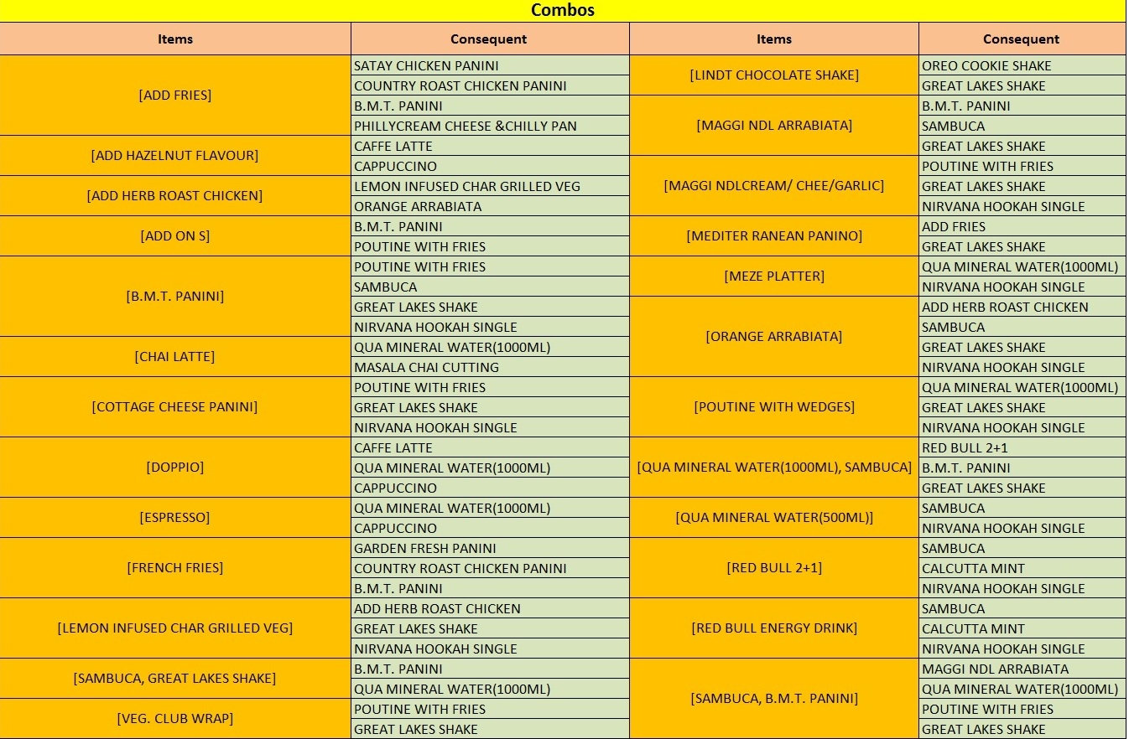
Combos and offers
From above table, we can provide different combo offers on the above listed items and their respective consequents. There by we could increase sales of the restaurant

Slide 19
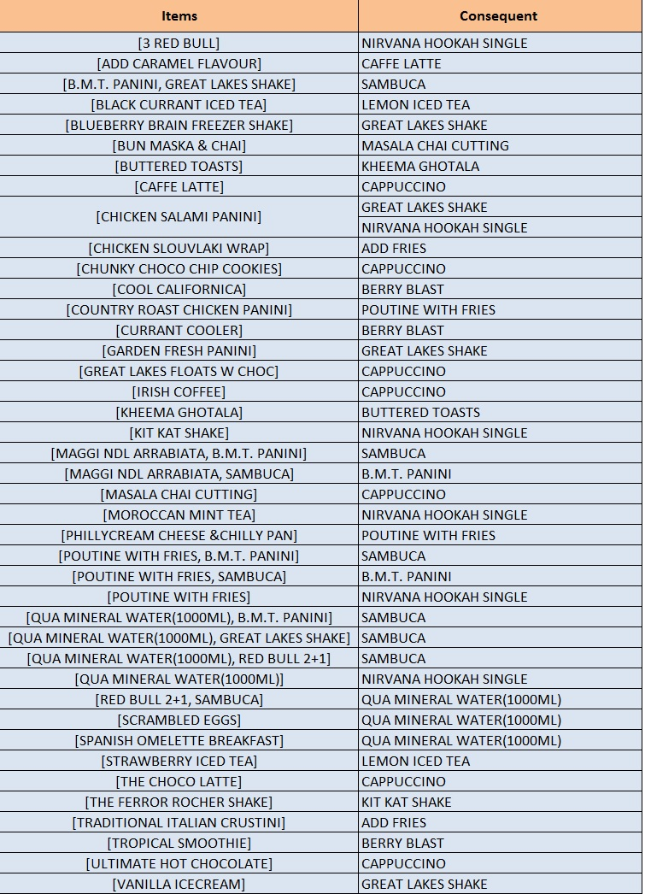
Recommendations
From above table, we can make buy one get one or 2+1 offers by joining the respective Items and Consequent. This will help in attracting more customers towards the restaurant.
The Restaurant can prepare catalog to place the optimally concerning category items together on the menu.There would be higher chances of order increase and resulting in the increase of revenue of the restaurant.
Providing more offers during weekdays and festival months would be good option to make best use of peak rush.

